Slide 1
Energy saving protocol for Adhoc network
TEAM-09
CSC-B

Slide 2
ABSTRACT
In ad hoc networks, devices connect without any fixed infrastructure and rely on battery power. If some devices use too much energy, the whole network can fail early. This project introduces an energy-saving routing method where devices choose paths not only based on distance but also on how much battery power each device has. We built a simple Python simulation to show how this method works. It helps balance energy usage, so no single device dies too quickly. This makes the network last longer and work better, especially in real-life situations like disaster zones or remote areas.

Slide 3
PROBLEM STATEMENT
In ad hoc networks, devices communicate directly without fixed infrastructure like routers or towers. These devices run on battery power, and if some nodes use more energy than others, they die quickly—causing the whole network to fail early. Most existing routing methods focus only on finding the shortest path but ignore battery levels. This project aims to develop an energy-saving protocol that balances energy use across all devices, helping the network last longer and work more reliably—especially in emergency or remote situations where recharging isn’t possible.

Slide 4
EXISTING SOLUTIONS
EAODV (Energy-Aware AODV) :
Overview: A smart upgrade of AODV that takes battery power into account while choosing routes.
Features: Picks routes based on both distance and energy levels, helping to spread out power usage and extend network life. However, it's a bit more complex to implement.
NS-3, OMNeT++, and QualNet (Simulators) :
Overview: Popular tools for simulating wireless networks including ad hoc networks.
Features: Realistic and detailed simulations, support for various protocols, but they're heavy, need good computer specs, and can be hard to learn for beginners.

Slide 5
Objective
Save Battery Life : Help the devices in the network use less power so their batteries last longer during communication.
Smart Path Selection : Choose routes for sending data that not only take the shortest way but also consider how much battery each device has left.
Balance the Load : Make sure no single device is overused. Spread out the work so all devices share the job of sending data, which keeps the network working longer.
Simple and Visual Simulation : Create an easy-to-understand simulation using Python that shows how this energy-saving method works in real life.

Slide 6
ALGORITHM
Start
Place the Nodes : Randomly scatter 10 wireless nodes on a 2D space.Each node starts with the same battery level (e.g., 100%)..
Build the Network : Connect two nodes with a link only if they are close enough (within 5 units of distance).This simulates real-world wireless communication range.
Find Possible Routes : Search for all possible paths from the source node (Node 0) to the destination node (Node 9).Only consider short paths (up to 4 hops) to keep things efficient.

Slide 7
4. Choose the Best Route Smartly : For each possible route:Calculate total distance of the route.Find the average energy level of all nodes in that route.Choose the route that gives the best balance between short distance and high energy.
5. Send the Packet and Update Energy : Send a packet through the selected path.Each node in the path spends a little energy (e.g., -5 units) to forward the packet.Then, visualize the path and the network to show how it looks.
6. Stop

Slide 8
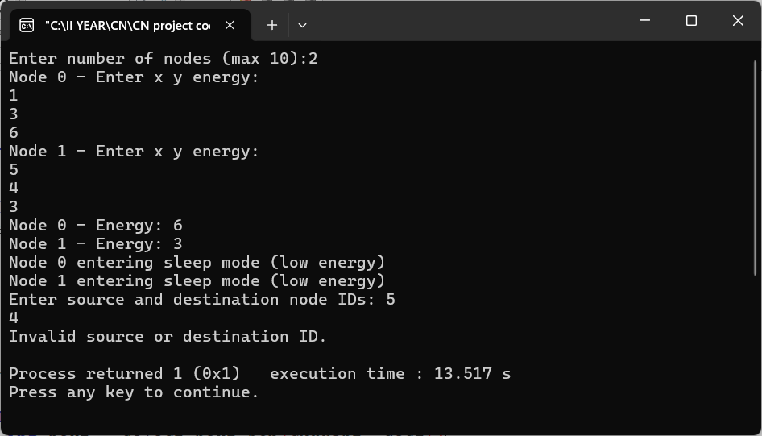
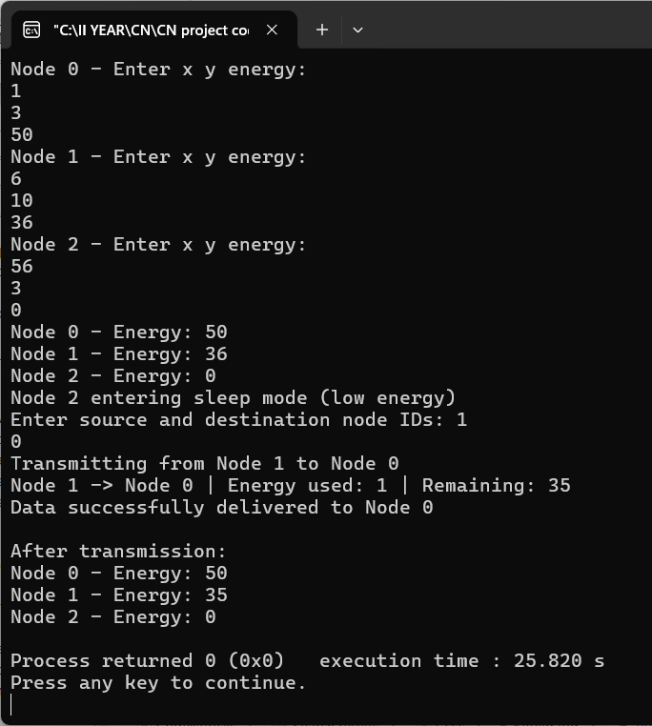
OUTPUT

Slide 9
ADVANTAGES
Longer Network Lifetime
Balanced Energy Usage
Better Performance in Dynamic Environments
DISADVANTAGES
Higher Computation Overhead
Less Focus on Shortest Path
Needs Real-Time Energy Updates

Slide 10
APPLICATIONS
Disaster Recovery and Emergency Networks
Military Communication Systems
Environmental and Wildlife Monitoring
Remote Area Communication
Healthcare and Wearable Networks
Vehicular Ad Hoc Networks (VANETs)
Smart Agriculture Systems
Internet of Things (IoT) Deployments

Slide 11


